Slide 1
COM4569/CMP4569
Data Mining
Week-1: Introduction
Asst. Prof. Dr. Damla Topallı
Ankara University

Slide 2
Terminology: Data, Information, Knowledge
Data Mining: Knowledge discovery from data.
Data: Unstructured, raw facts. It can be useful or not.
Information: Information is the data that is organized.
  It’s meaning value is higher than the data.
Knowledge:
  Knowledge is the collection of the information.
  It refers to the practical use of information.
  It must be meaningful and useful.
  Knowledge is a decision mechanism.

Slide 3
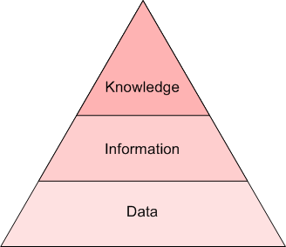
Terminology: Data, Information, Knowledge
Making Decisions
Combined
Analysed
Summarized
Organized
Collected

Slide 4
Evolution of Database Technology
1960s:
  Data collection, database creation, IMS and network DBMS
1970s:
  Relational data model, relational DBMS implementation
1980s:
  RDBMS, advanced data models (extended-relational, OO, deductive, etc.)
  Application-oriented DBMS (spatial, scientific, engineering, etc.)
1990s:
  Data mining, data warehousing, multimedia databases, and Web databases
2000s
  Stream data management and mining
  Data mining and its applications
  Web technology (XML, data integration) and global information systems

Slide 5
Current State of Data Mining
Data Mining is a new and active area of technological development.
Many new data mining algorithms for mining techniques like classification, and clustering were developed.
Data mining software tools such as IBM Intelligent Miner, Clementine, SPSS, Microsoft SQL Server (extend to include Data Mining facilities) and Weka are widely used.
Main Application Areas:
  Finance, Marketing, Medicine, Biology, so on..

Slide 6
Why Data Mining?
The Explosive Growth of Data: from terabytes to petabytes (Big Data!)
  Data collection and data availability
    Automated data collection tools, database systems, Web, computerized society
  Major sources of huge data
    Business: Web, e-commerce, transactions, stocks, …
    Science: Remote sensing, bioinformatics, scientific simulation, …
    Society and everyone: news, digital cameras, YouTube
We are drowning in data, but starving for knowledge!

Slide 7
Big Data Examples
Europe's Very Long Baseline Interferometry (VLBI) has 16 telescopes, each of which produces 1 Gigabit/second of astronomical data over a 25-day observation session
  storage and analysis a big problem
AT&T handles billions of calls per day
  so much data, it cannot be all stored -- analysis has to be done “on the fly”, on streaming data
data is measured in Exabytes
  What is exabyte?
    1024 Megabytes = 1 Gigabyte
    1024 Gigabytes = 1 Terabyte
    1024 Terabytes = 1 Petabyte
    1024 Petabytes = 1 Exabyte

Slide 8
Data Growth: From Terabytes to the Zettabyte Era
Global data creation and consumption has grown dramatically.
2020: ~64 ZB
2025: ~180 ZB
2028: >390 ZB (forecast)
1 Zettabyte (ZB) = 1 billion Terabytes (TB)
Why does this matter?
Collecting data is no longer the main challenge.
The challenge is extracting useful, reliable, and actionable knowledge from massive, complex, and rapidly generated datasets.

Slide 9

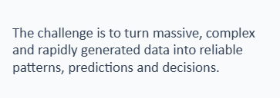
Data Growth: From Terabytes to the Zettabyte Era
DATA MINING IS NEEDED TO:
Discover patterns
Build predictive models
Detect anomalies
Support data-driven decisions

Slide 10


What Is Data Mining?
Data mining (knowledge discovery from data)
  Extraction of interesting (non-trivial, implicit, previously unknown and potentially useful) patterns or knowledge from huge amount of data
Alternative names
  Knowledge discovery (mining) in databases (KDD), knowledge extraction, data/pattern analysis, data archeology, data dredging, information harvesting, business intelligence, etc.

Slide 11
Data Mining: Useful Information
Example 1 (A well-known example, not a joke):
Customers who purchase beer are also likely (say 90%) to purchase nappies.
Example 2 (May already be in practical use in credit card applications):
If 20,000 ≤ Customer’s Salary ≤ 40,000 pounds and Customer has a house, then Customer is a safe customer.

Slide 12
Origins of Data Mining
Draws ideas from machine learning/AI, pattern recognition, statistics, and database systems
Traditional Techniques
may be unsuitable due to
  Enormity of data
  High dimensionality
  of data
  Heterogeneous,
  distributed nature
  of data
Statistics/
AI
Machine Learning/
Pattern
Recognition
Data Mining
Database systems

Slide 13
Data Mining: Confluence of Multiple Disciplines
Database
Technology
Statistics
Machine
Learning
Data Mining
Visualization
Information
Science
Other
Disciplines

Slide 14
Data Mining: On What Kind of Data?
Relational databases
Data warehouses
Transactional databases
Advanced DB and information repositories
  Object-oriented and object-relational databases
  Spatial databases - images
  Time-series data and temporal data, sequence data
  Text databases and multimedia databases
  Heterogeneous and legacy databases
  WWW
  Data streams of sensors
  Structured data – networks, graphs
  Spatiotemporal - video

Slide 15
Why Data Mining?—Potential Applications
Data analysis and decision support
  Market analysis and management
    Target marketing, customer relationship management (CRM), market basket analysis, cross selling, market segmentation
  Risk analysis and management
    Forecasting, customer retention, improved underwriting, quality control, competitive analysis
  Fraud detection and detection of unusual patterns (outliers)
Other Applications
  Text mining (news group, email, documents) and Web mining
  Stream data mining
  Bioinformatics and bio-data analysis
  Medicine
  Agriculture
  Society, politics and economics
  Science
  Engineering
  Law enforcement
  Military and intelligence (classified)

Slide 16
Customer Attrition (Losing Customer): Example
Situation: Attrition rate at for mobile phone customers is around 25-30% a year!
With this in mind, what is our task?
  Assume we have customer information for the past N months.
Task:
Predict who is likely to attrite next month.
Estimate the cost-effective offer to be made to this customer.

Slide 17
Assessing Credit Risk: Example
Situation: Person applies for a loan
Task: Should a bank approve the loan?
Note: People who have the best credit don’t need the loans, and people with worst credit are not likely to repay. Bank’s best customers are in the middle.
Banks develop credit models using variety of machine learning methods.

Slide 18
e-commerce: Example
A person buys a book (product) at Amazon.com
What is the task?

Slide 19
Successful e-commerce – Example
Task: Recommend other books (products) this person is likely to buy.
Amazon does clustering based on books bought:
  customers who bought “Advances in Knowledge Discovery and Data Mining”, also bought “Data Mining: Practical Machine Learning Tools and Techniques with Java Implementations”
Recommendation program is quite successful

Slide 20
Health Care– Example
Given data for a number of samples (patients), can we
Accurately diagnose the disease?
Predict outcome for given treatment?
Recommend best treatment?

Slide 21
Major Data Mining Tasks
Classification: predicting an item class
Clustering: finding clusters in data
Associations: e.g. A & B & C occur frequently
Visualization: to facilitate human discovery
Summarization: describing a group
Deviation Detection: finding changes
Estimation: predicting a value
Link Analysis: finding relationships
…

Slide 22
Knowledge Discovery (KDD) Process
Knowledge
  Data mining—core of knowledge discovery process
Pattern Evaluation
Data Mining
Task-relevant Data
Data Warehouse
Selection
Data Cleaning
Data Integration
Databases

Slide 23
KDD Process: Several Key Steps
Learning the application domain
  relevant prior knowledge and goals of application
Creating a target data set: data selection
Data cleaning and preprocessing: (may take 60% of effort!)
Data reduction and transformation
  Find useful features, dimensionality/variable reduction, invariant representation
Choosing functions of data mining
  summarization, classification, regression, association, clustering
Choosing the mining algorithm(s)
Data mining: search for patterns of interest
Pattern evaluation and knowledge presentation
  visualization, transformation, removing redundant patterns, etc.
Use of discovered knowledge

Slide 24
Challenges of Data Mining
Scalability
Dimensionality
Complex and Heterogeneous Data
Data Quality
Data Ownership and Distribution
Privacy Preservation
Streaming Data

Slide 25
Lecture 2

Slide 26
Getting to Know Your Data
Data Objects and Attribute Types
Basic Statistical Descriptions of Data
Data Visualization
Measuring Data Similarity and Dissimilarity
Summary

Slide 27
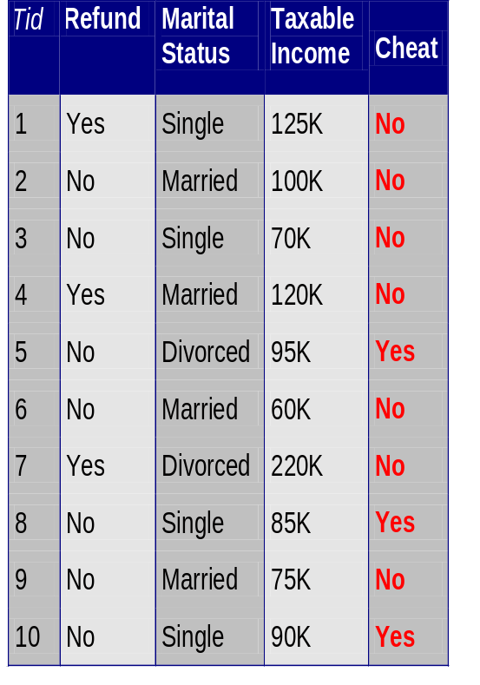
What’s an attribute?
Data: Collection of data objects and their attributes
Each instance/Object/record/point/ case/sample/entity is described by a fixed predefined set of features, its “attributes”
  An attribute/variable/ field/ characteristic/ feature is a property or characteristic of an object
  Examples: eye color of a person, temperature, etc.
Possible attribute types (“levels of measurement”):
  Qualitative: Nominal, ordinal,
  Quantitative (numeric): interval and ratio
Attributes
Objects

Slide 28
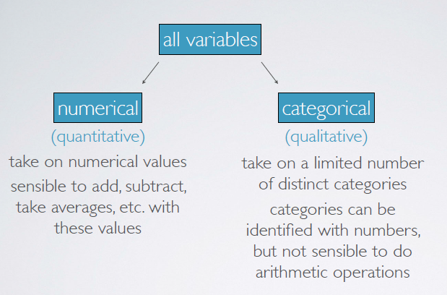
Attribute Types

Slide 29
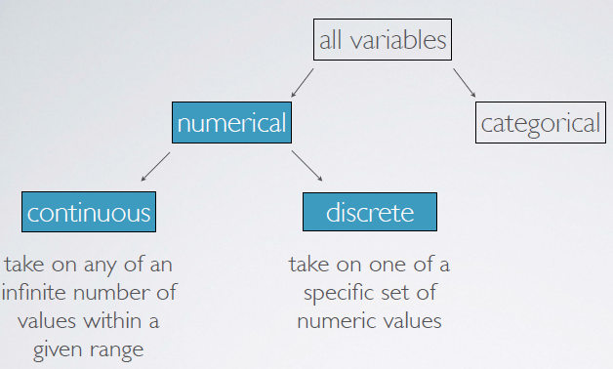
Attribute Types

Slide 30
Why specify attribute types?
Q: Why Machine Learning algorithms need to know about attribute type?
A: To be able to make right comparisons and learn correct concepts, e.g.
  Outlook > “sunny” does not make sense, while
  Humidity > 70 does
Additional uses of attribute type: check for valid values, deal with missing, etc.

Slide 31
Measures for Quantitative Data
Mean- arithmetic average
Median midpont of the distribution (50 percentile)
Mode (most frequent observation)
Example: 9 students exam scores: 75, 69, 88, 93,95, 54, 87,88,27
  Mean=sum/9=75.1
  Mode=88
  Median= 27 54 69 75 87 88 88 93 95 → ??
Example: 9 students exam scores: mode?
  27 54 69 75 87 88 88 93 95 100 mode=???

Slide 32
DATA PREROCESSING

Slide 33
The Aim of Data Preprocessing
The data encountered in real life usually happens to be incomplete, noisy ,inconsistent.
The aims of data preprocessing
    To improve the quality of DB
    To ease DB.
    To increase productivity.

Slide 34
Why Data Preprocessing?
Preprocessing the data is very significant in the sense that the quality of the data collected will affect the results.
If the obtained data is in low quality, the data mining will also be low quality.

Slide 35
Measures for data quality
Measures for data quality: A multidimensional view
  Accuracy: correct or wrong, accurate or not
  Completeness: not recorded, unavailable, …
  Consistency: some modified but some not, …
  Timeliness: timely update?
  Believability: how trustable the data are correct?
  Interpretability: how easily the data can be understood?

Slide 36
Data Quality Problems
What kinds of data quality problems?
  Incomplete data
  Noisy data (incorrect values)
  Inconsistent Data
  Duplicate Records
  Outliers
What can we do about these problems?
  We should use Data Preprocessing Techniques!

Slide 37
Data Quality Problems
Incomplete data may come from
  “Not applicable” data value when collected
  Different considerations between the time when the data was collected and when it is analyzed.
  Human/hardware/software problems
Noisy data (incorrect values) may come from
  Faulty data collection instruments
  Human or computer error at data entry
  Errors in data transmission
Inconsistent data may come from
  Different data sources
  Functional dependency violation (e.g., modify some linked data)
Duplicate records

Slide 38
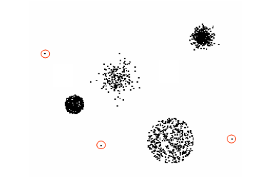
Outliers
Outliers are data objects with characteristics that are considerably different than most of the other data objects in the data set

Slide 39
Examples
Data in the Real World Is Dirty: Lots of potentially incorrect data,
  incomplete: lacking attribute values, lacking certain attributes of interest, or containing only aggregate data
    e.g., Occupation = “ ” (missing data)
  noisy: containing noise, errors, or outliers
    e.g., Salary = “−10” (an error)
  inconsistent: containing discrepancies in codes or names, e.g.,
    Age = “42”, Birthday = “03/07/2010”
    Was rating “1, 2, 3”, now rating “A, B, C”
    conflict between duplicate record.

Slide 40
How can the problems regarding the data quality can be solved?
By detecting the error and fixing the data (Data cleaning)
By tolerating the low data qualities by applying the algorithms (Data Preprocessing Techniques)

Slide 41
Data Preprocessing Techniques
Data cleaning
  Fill in missing values, smooth noisy data, identify or remove outliers, and resolve inconsistencies
Data integration
  Integration of multiple databases, data cubes, or files
Data reduction
  Dimensionality reduction
  Data compression
Data transformation
  Normalization

Slide 42
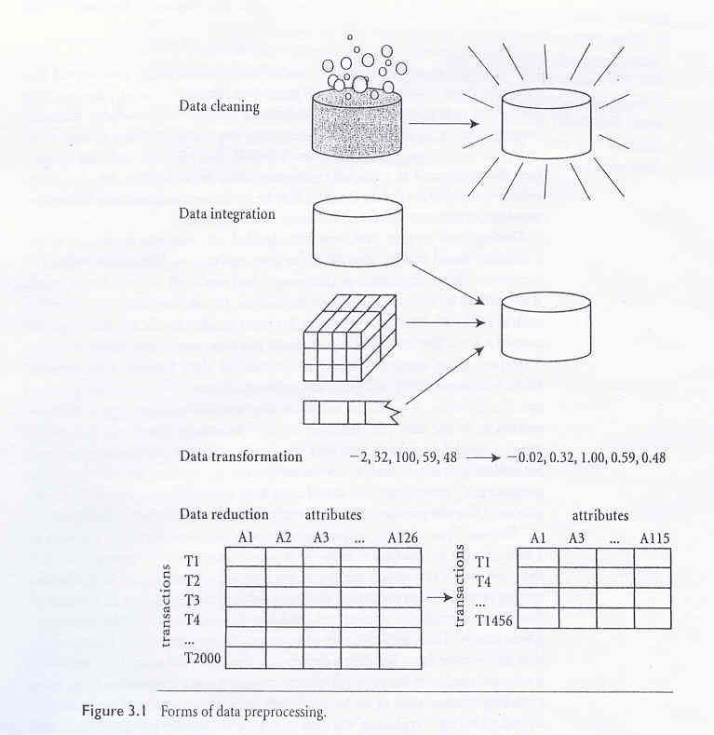
Data Preprocessing Techniques

Slide 43
Data Cleaning Techniques
Binning
  first sort data and partition into (equal-frequency) bins
  then one can smooth by bin means, smooth by bin median, smooth by bin boundaries, etc.
Regression
  smooth by fitting the data into regression functions
Clustering
  detect and remove outliers

Slide 44
Example: Binning Method
Sorted data for price (in dollars): 4, 8, 9, 15, 21, 21, 24, 25, 26, 28, 29, 34
* Partition into equal-frequency (equi-depth) bins:
- Bin 1: 4, 8, 9, 15
- Bin 2: 21, 21, 24, 25
- Bin 3: 26, 28, 29, 34
* Smoothing by bin means:
- Bin 1: 9, 9, 9, 9
- Bin 2: 23, 23, 23, 23
- Bin 3: 29, 29, 29, 29
* Smoothing by bin boundaries:
- Bin 1: 4, 4, 4, 15
- Bin 2: 21, 21, 25, 25
- Bin 3: 26, 26, 26, 34

Slide 45
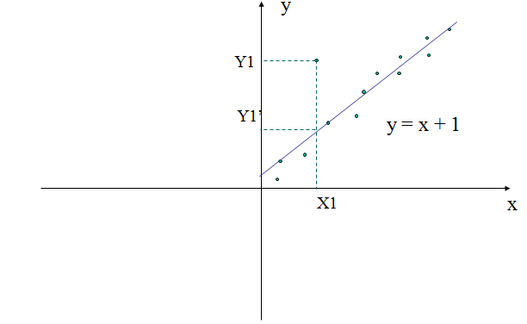
Regression
  Smooth by fitting the data into regression functions

Slide 46
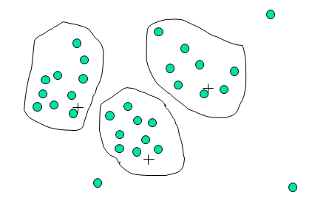
Cluster Analysis
  Used to detect and remove outliers

Slide 47
QUESTIONS?
Why is it important to preprocess data for data mining? What is the aim of data preprocessing?
What are the problems that reduce data quality? How can we solve these problems?
Write the methods for data cleaning.

Slide 48
QUESTIONS?
4. You’re going to implement a data mining application. To decrease noise for age attribute, use binning method- smooth by bin means. Data set is given below. Partition the data into equal frequency of 3 bins.
Age: 13, 15, 16, 19, 20, 20, 23, 25, 30, 32, 35, 35
Bin # | Data | Smooth By Mean
1
2
3

Slide 49
MEASURING SIMILARITY AND DISSIMILARITY

Slide 50
Similarity and Dissimilarity
Similarity
  Numerical measure of how alike two data objects are.
  Often falls between 0 (no similarity) and 1 (complete similarity).
Dissimilarity
  Numerical measure of how different are two data objects
  Range from 0 (objects are alike) to ∞ (objects are different)

Slide 51
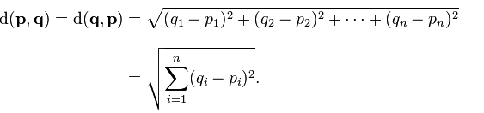
Measuring Similarity and Dissimilarity
We should use Distance Metrics to measure similarity and dissimilarity.
Euclidean Distance
The Euclidean distance between points p and q is the length of the line segment connecting them.
Minkowski Distance
Mahalanobis Distance

Slide 52
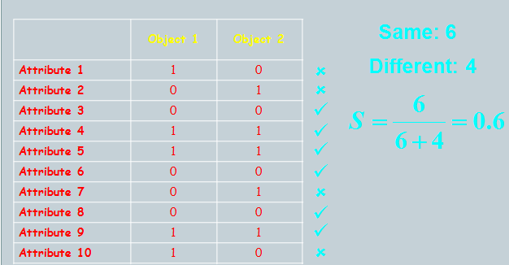
Example: How similar are these objects?

Slide 53
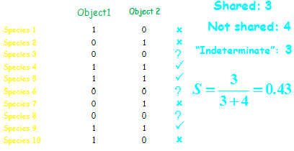
Example 2: How similar are these objects?
In this example shared zeroes treated as uninformative

Slide 54
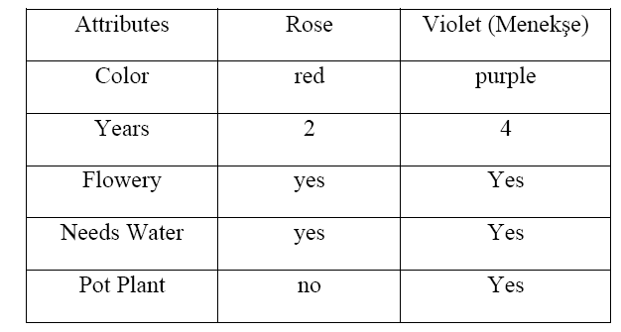
QUESTIONS?
What is similarity and dissimilarity? How can we measure the similarity between the objects? Give 2 examples for measure method.
How similar are these two objects (calculate similarity)?

